Slide 1

INTRODUCTION TO YOUR PROJECT
The AI agent, known as the "Personal Wellness Mentor," is designed to assist users in achieving their personal well-being goals. This agent uses AI-driven insights and personalized coaching to help users manage their physical and mental health, productivity, and overall well-being. The agent can interact with users to provide tailored guidance and support.
User can choose between agents such as nutritionist, fitness coach and counsellor.
SUMMER HACK

Slide 2
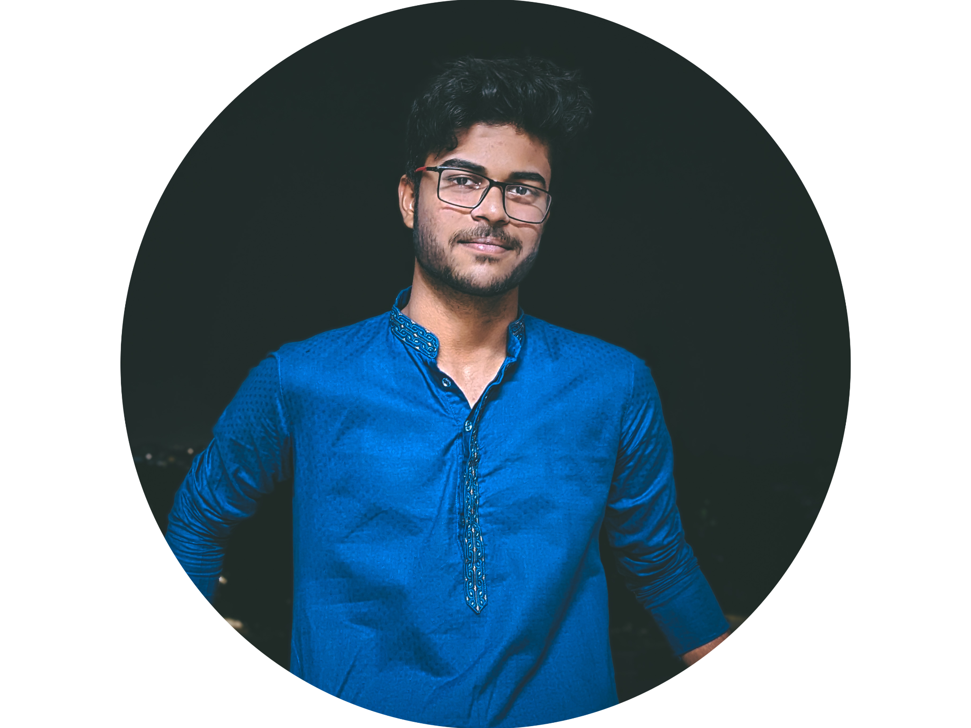


INTRODUCE YOUR TEAM
Frontend & Backend Asutosh Behuria
AI ML & Backend Prerit Agrawal
UI/UX & Frontend
Soham Samantaray
SUMMER HACK

Slide 3
PROBLEM STATEMENT:
AI Agent to improve the physical and psychological health of the user.
SUMMER HACK

Slide 4
STACK YOU ARE PLANNING TO USE:
UI/UX - Figma
Frontend - ReactJS + Typescript
Backend - NodeJS
AI Agent - Python
DB - mongoDB
SUMMER HACK

Slide 5
BLUEPRINT OF THE TOOL:
SUMMER HACK

